Slide 1
SmartSpace
Project Guide
Mr. Eldhose K Paul
Associate Professor
Department of Computer Applications
Tom Joseph Ellickal S4 MCA
Roll No:58

Slide 2
Introduction
AI-driven interior design system automates layout generation using Stable Diffusion models.
Traditional interior design is time-consuming, costly, and lacks easy visualization before execution.
The system analyzes room images, dimensions, and user preferences to create personalized designs.
Supports multiple room types and design styles such as modern, minimalist, and rustic.
Enables faster decision-making, better visualization, and reduced design effort for users and professionals.

Slide 3
Abstract
This project presents an AI-driven interior design system that uses the Stable Diffusion model to generate personalized room layouts and design recommendations. The system analyzes room images, dimensions, and user preferences to produce visually appealing and functional interior designs. It supports multiple room types and design styles, enabling users to easily visualize design options before implementation. By automating the design process, the system reduces time, cost, and effort while improving efficiency and accessibility for both professionals and non-expert users.

Slide 4
Problem Identification
Traditional interior design is time-consuming and expensive.
Users struggle to visualize designs in advance.
Existing tools offer limited personalization.
There is no efficient automated system for personalized interior design generation.
There is a need for an AI-based solution that saves time, cost, and effort while providing customized designs.

Slide 5
Problem Statement
Users find it difficult to visualize designs before execution.
Existing design tools offer limited personalization.
Current systems lack intelligent automation.
There is a need for an AI-based interior design system that can generate personalized designs efficiently.
The system should reduce time, cost, and manual effort while improving design visualization
Traditional interior design is time-consuming and expensive.

Slide 6
Proposed System
An AI-based interior design system for automated design generation.
Users can upload room images and provide design preferences.
The system generates personalized interior designs using AI models.
Supports multiple design styles and layouts.
Helps users visualize designs before execution.
Reduces time, cost, and manual effort.
Minimizes dependency on professional interior designers.

Slide 7
Literature Review
TITLE & YEAR | AUTHOR & PUBLICATION | ALGORITHM USED | FEATURE EXTRACTED / METHODOLOGY | PERFORMANCE METRIC | RESULT / FINDINGS
Smart Home Decor Recommendation Using Multimodal AI (2025) | T. Joseph et al., Elsevier Applied AI | Multimodal Transformers | Image-text preference fusion | Accuracy, User Rating | Enhanced recommendation relevance and usability
Generative AI for Personalized Room Decoration (2025) | N. Rao et al., ACM Transactions on Graphics | GAN + Diffusion | Style synthesis, user preference learning | MOS, Visual Realism | Generated highly customized and photorealistic room designs
Vision-Based Room Decor Recommendation Platform (2024) | A. Verma et al., IEEE ICCV Workshops | Vision Transformer (ViT) | Semantic room understanding, object embeddings | Top-K Accuracy | Improved decor matching over CNN-based models
AI-Based 3D Room Decor Visualization System (2024) | R. Das et al., Elsevier Future Generation CS | GANs, CNN | 3D model generation, texture synthesis | SSIM, User Feedback | Generated realistic decor layouts with high visual similarity
AI-Powered Personalized Interior Design System (2023) | J. Thomas, A. Paul, IEEE Smart Systems Journal | CNN + Collaborative Filtering | Style similarity, user behavior analysis | Recommendation Accuracy | Personalization improved user satisfaction by 32%

Slide 8
Modules of Proposed System
User Interface Module
Image Processing Module
Preference Analysis Module
AI Design Generation Module
Design Recommendation Module
Visualization & Output Module

Slide 9
Tools and Technologies
Front-End
- HTML
- CSS
- JavaScript
Back-End
- Python
Database
- SQL

Slide 10
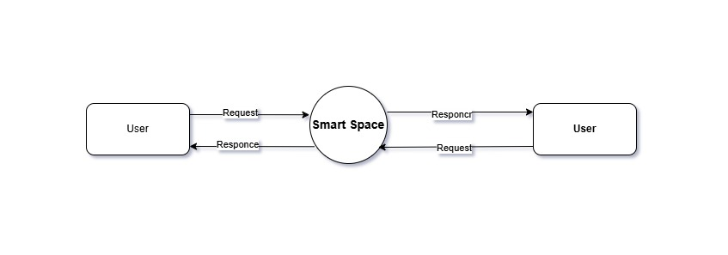
DESIGN AND DIAGRAMS
LEVEL ZERO DFD

Slide 11
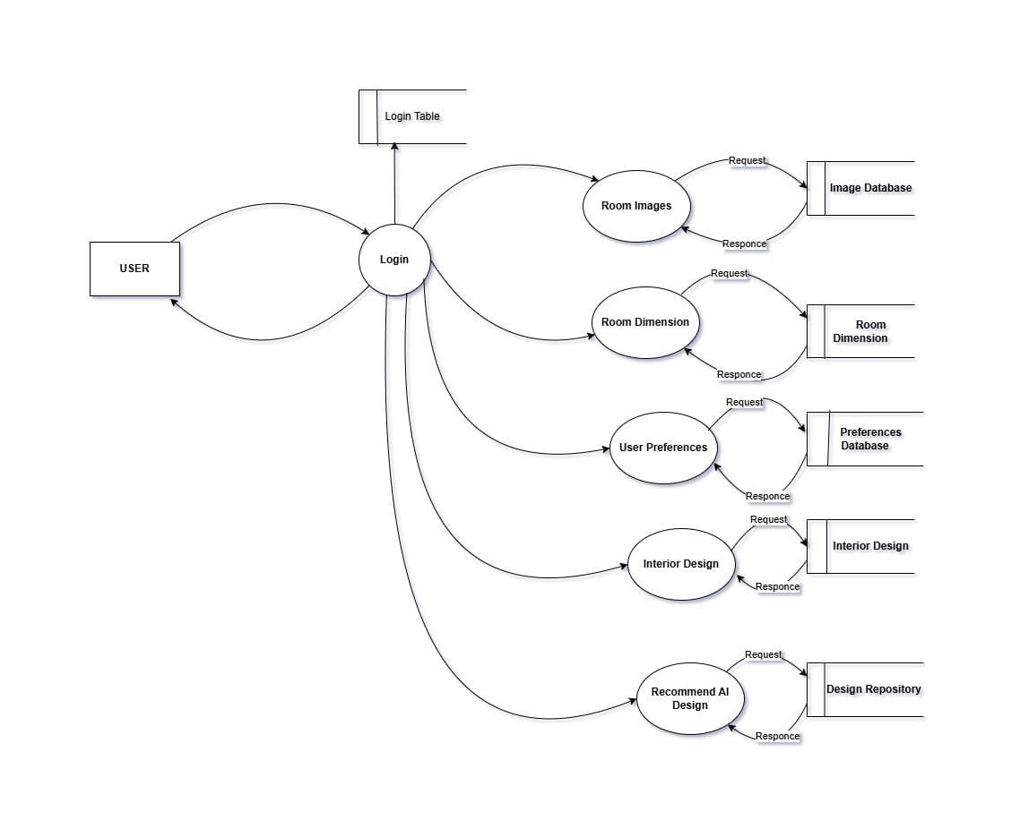
LEVEL ONE DFD

Slide 12
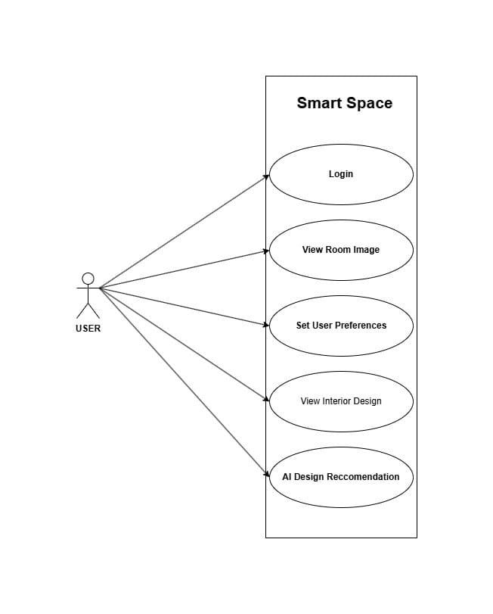
USE CASE DIAGRAM

Slide 13
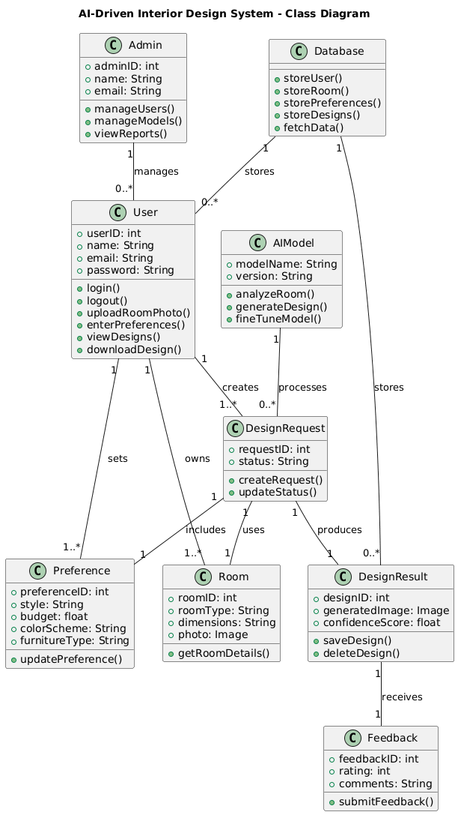
CLASS DIAGRAM

Slide 14
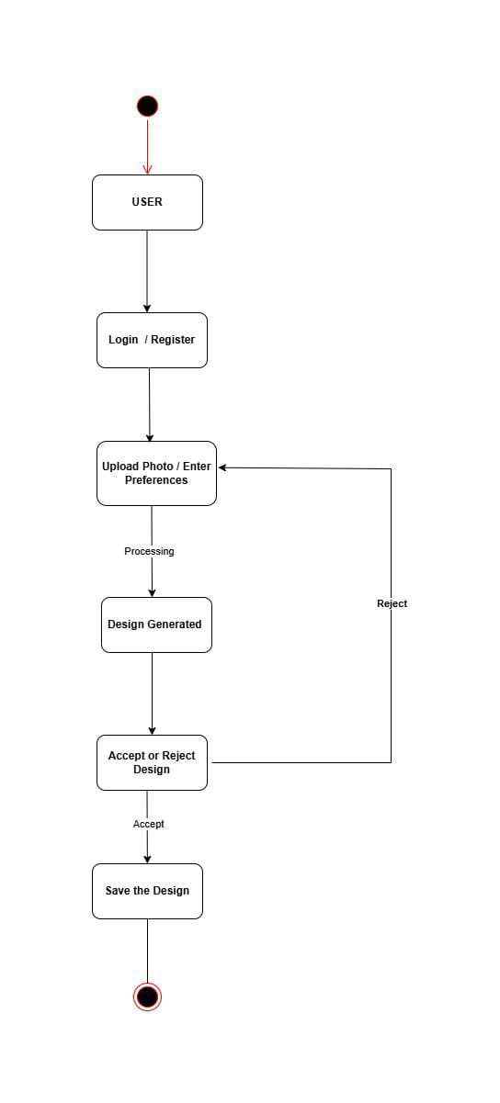
STATE DIAGRAM

Slide 15
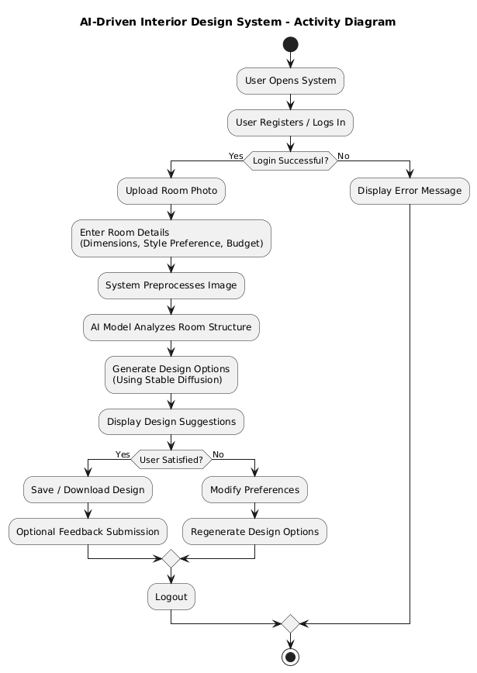
ACTIVITY DIAGRAM

Slide 16
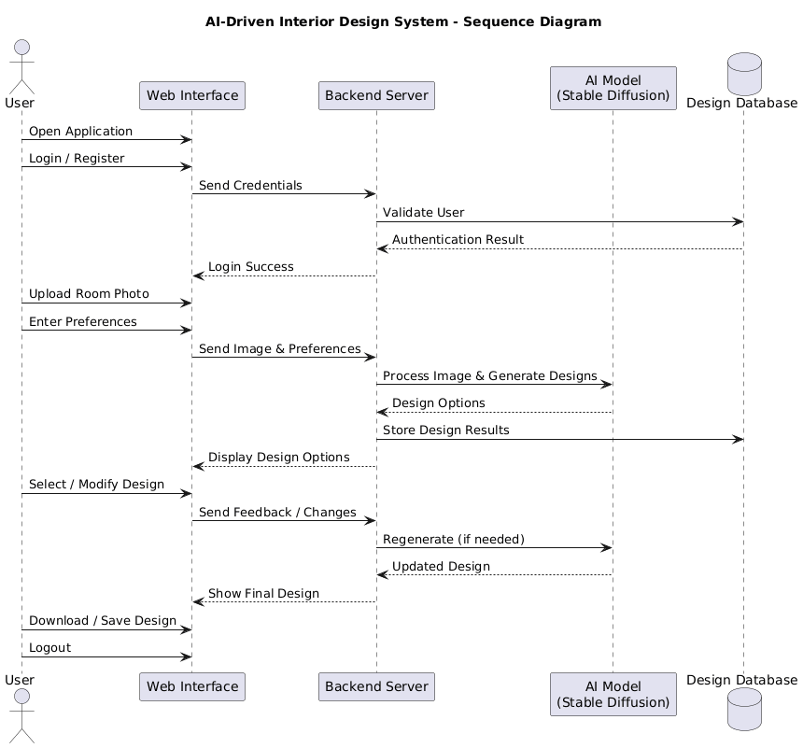
SEQUENCE DIAGRAM

Slide 17
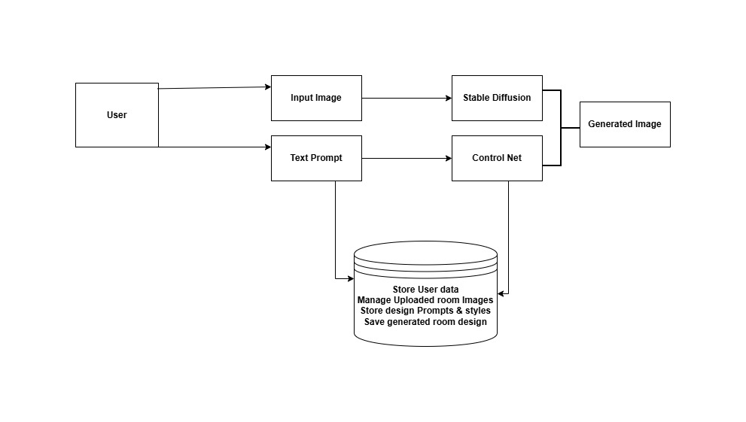
ARCHITECHTURE OF THE SYSTEM

Slide 18
COMPARISON WITH EXISTING SYSTEM
Feature | Existing Smart Space | Proposed Smart Space
System Intelligence | Low intelligence | High intelligence with learning capability
Environmental Impact | Higher energy wastage | Energy-efficient and eco-friendly
Maintenance | High maintenance cost and effort | Low maintenance with predictive maintenance features
Fault Detection | Manual fault identification | Automatic fault detection and self-diagnosis

Slide 19
LIMITATIONS AND FUTURE SCOPE
Design accuracy depends on the quality of input images and user data
AI-generated designs may not fully match real-world constraints like budget or materials
Limited customization for highly complex or irregular room structures.
Requires high computational resources for faster image generation.
Requires high computational resources for faster image generation.

Slide 20
Integration of real-time 3D visualization and AR/VR support.
Inclusion of cost estimation and material availability features
Improved personalization using user feedback and adaptive learning.
Support for more design styles and regional interior preferences.
Deployment as a mobile and cloud-based application for wider accessibility.

Slide 21
REFERENCES
[1] I. Goodfellow, Y. Bengio, and A. Courville, Deep Learning. Cambridge, MA, USA: MIT Press, 2016.
[2] R. Rombach, A. Blattmann, D. Lorenz, P. Esser, and B. Ommer, “High-resolution image synthesis with latent diffusion models,” in Proc. IEEE Conf. Computer Vision and Pattern Recognition (CVPR), 2022, pp. 10684–10695.
[3] A. Radford, L. Metz, and S. Chintala, “Unsupervised representation learning with deep convolutional generative adversarial networks,” in Proc. Int. Conf. Learning Representations (ICLR), 2016.
[4] D. P. Kingma and M. Welling, “Auto-encoding variational Bayes,” in Proc. Int. Conf. Learning Representations (ICLR), 2014.
[5] O. Ronneberger, P. Fischer, and T. Brox, “U-Net: Convolutional networks for biomedical image segmentation,” in Proc. Int. Conf. Medical Image Computing and Computer-Assisted Intervention, 2015, pp. 234–241.

Slide 22
[6] J. Redmon and A. Farhadi, “YOLOv3: An incremental improvement,” arXiv preprint arXiv:1804.02767, 2018.
[7] K. He, X. Zhang, S. Ren, and J. Sun, “Deep residual learning for image recognition,” in Proc. IEEE Conf. Computer Vision and Pattern Recognition (CVPR), 2016, pp. 770–778.
[8] T. Karras, S. Laine, and T. Aila, “A style-based generator architecture for generative adversarial networks,” in Proc. IEEE Conf. Computer Vision and Pattern Recognition (CVPR), 2019, pp. 4401–4410.
[9] S. J. Russell and P. Norvig, Artificial Intelligence: A Modern Approach, 4th ed. Upper Saddle River, NJ, USA: Pearson, 2021.
[10] Y. LeCun, Y. Bengio, and G. Hinton, “Deep learning,” Nature, vol. 521, no. 7553, pp. 436–444, May 2015.

Slide 23
Thank You

